Slide 1
Assignment 2
ORUGANTI SAI TARUN

Slide 2
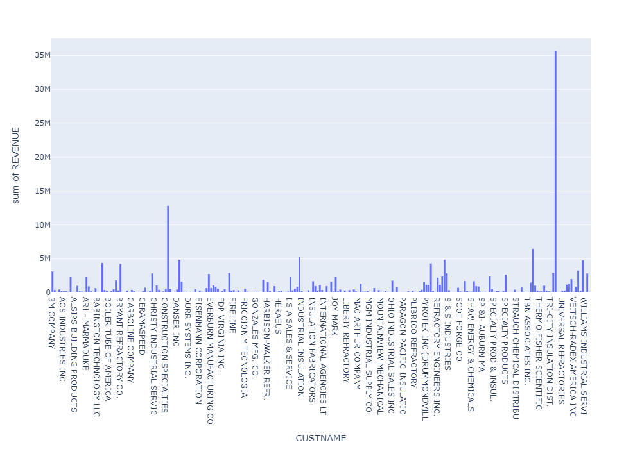
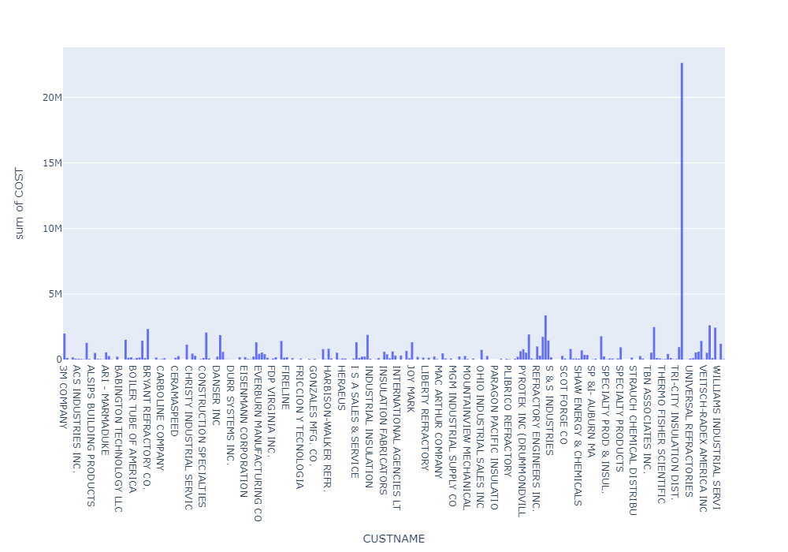
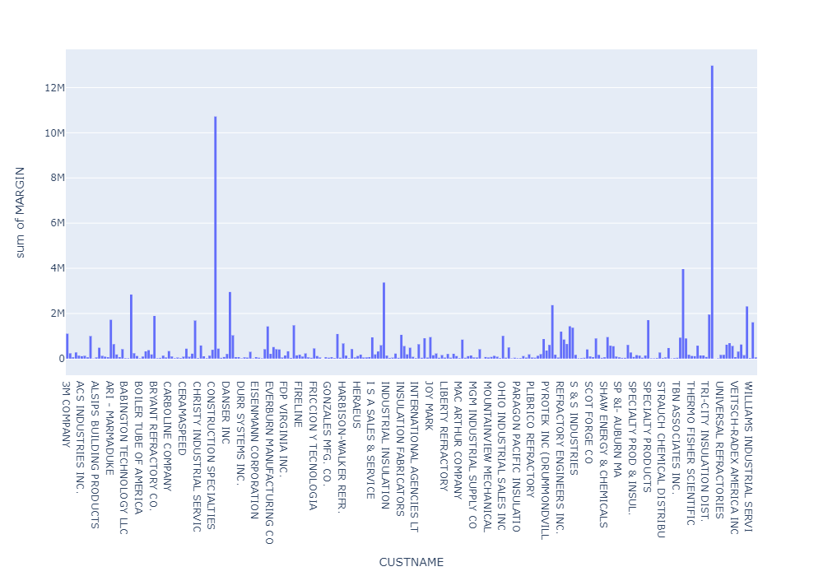
Who are the most loyal customers?
Here i identified the Most loyal customers are TRIUMPH INSULATION & CORNING SHARED SERVICES.
TRIUMPH INSULATION This Customer generates the revenue is 3,55,92,531.239999995, also the total cost is 2,26,21,006.61 and total Margin is 1,29,71,524.63.
CORNING SHARED SERVICES This Customer generates the revenue is 1,28,43,518.780000001, also the total cost is 20,77,213.24 and total Margin is 1,07,66,305.540000001.

Slide 3
Reasons To Take the most loyal customers:
Reason1:- TRIUMPH INSULATION buying cost is 2,26,21,006.61, the profit is 1,29,71,524.63 and revenue is 3,55,92,531.239999995
Reason2:- CORNING SHARED SERVICES buying cost is 20,77,213.24, the profit is 1,07,66,305.540000001 and revenue is 1,28,43,518.780000001
comparing to both, CORNING SHARED SERVICES buying cost is low and revenue is high approximately 6times high to the cost and it’s generates the 83% Margin to compare with revenue, cost and margin.
The TRIUMPH INSULATION buying cost is high and revenue is high approximately just double to the cost. and it’s generates the 36% Margin to compare with revenue, cost and margin.
so i am taken the decision is CORNING SHARED SERVICES and TRIUMPH INSULATION are Most loyal Customer.

Slide 4
Which customers contribute the most to their revenue?
Here i identified the "CORNING SHARED SERVICES" are contributing the revenue is 1,28,43,518.780000001.
"TRIUMPH INSULATION" are contributing the revenue is 3,55,92,531.239999995.
So these both customers contribute the most to their revenue.

Slide 5
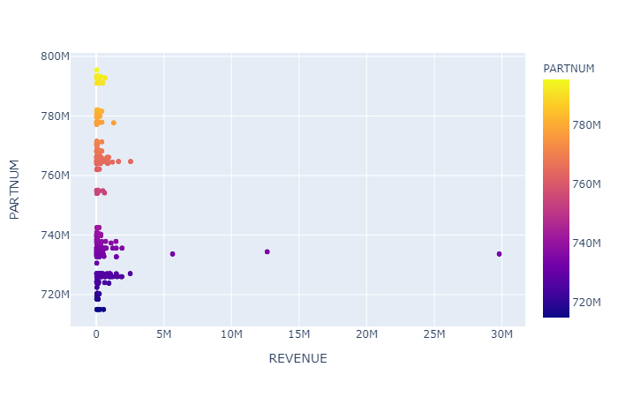
What part numbers bring in to significant portion of revenue?
PARTNUM(733648000): 3,00,50,020.380000003
PARTNUM(735602000): 1,56,52,151.350000001
PARTNUM(734370000): 1,26,41,200.0
These 3 part numbers bring in to significant portion of revenue.

Slide 6
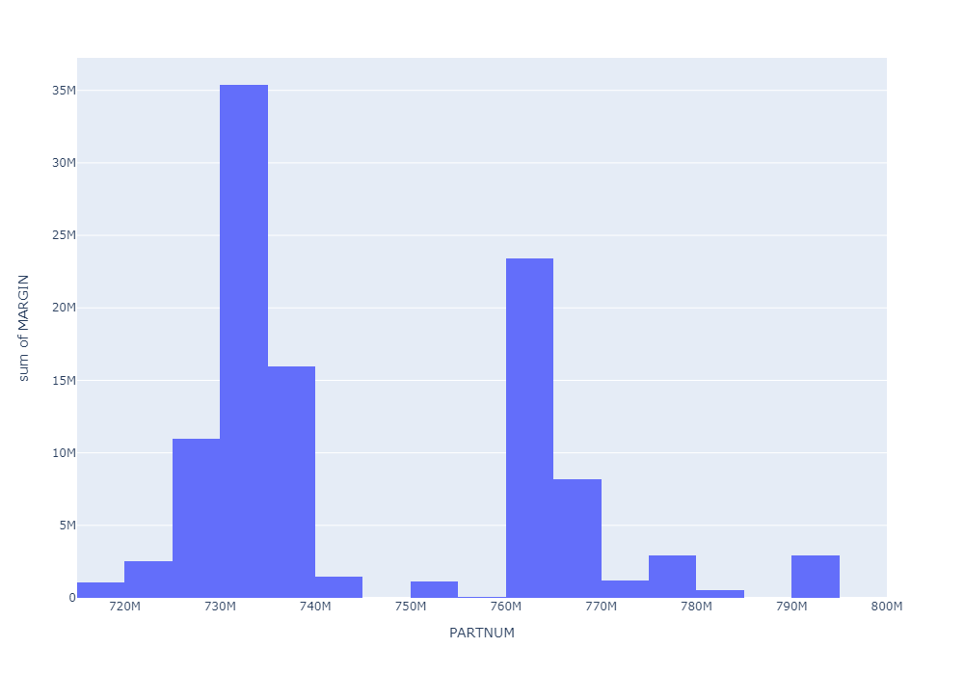
What parts have the highest profit margin?
PARTNUM(733648000): 1,09,88,584.309999999
PARTNUM(735602000): 1,02,02,203.26
PARTNUM(734370000): 1,06,27,732.81
These 3 parts have the Highest Profit Margin.

Slide 7
Assumptions
The data which is provided by the Customer that is representative data.
To identify the loyal customers, I am taken mean of the data and analysis the data >mean, for easy to identified the loyal customers.
Derivative fields : are done according to my knowledge what I am understand in data only.
Thank You & Regards
Oruganti. Sai Tarun
Notes:
In Slide Show mode, click the arrow to enter the PowerPoint Getting Started Center.

